Slide 1
Data Models cont.
The relational model of data is the most widely used model today.
➔ Main concept: relation, basically a table with rows
and columns.
➔ Every relation has a schema, which describes the
columns, or fields.

Slide 2
Instances and Schemas
Schema – A schema is a description of a particular collection of data, using the a given data model.
Schema is the overall design of database.
In RDBMS context:
Schema – table names, attribute names with their data types for each table and constraints etc.
Data in a database at particular moment is called database state or snapshot.
It is sometimes called the current state or instances in database. Eg. Entry in student table.
DBMS stores description of schema construct and constraints known as Metadata.
The Schema is sometimes called Intension and instance is called extension of schema
Name | Roll | Class | Subject

Slide 3
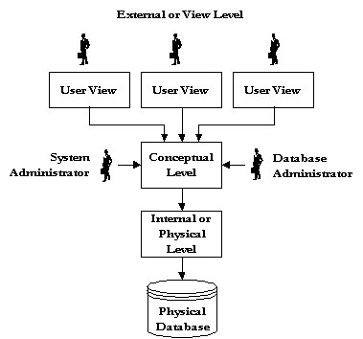
Levels of Abstraction: Three-schema Architecture

Slide 4
Physical level:
  describes details of how data is stored: files, indices, etc. on the random
  access disk system
  It also typically describes the record layout of files and type of files (hash,
  b-tree, flat).
Conceptual level(logical):
  Describes data stored in database, and the relationships among the data.
  Hides details of the physical level.
  In the relational model, the conceptual schema presents data as a set of tables
type customer = record
name : string;
street : string;
city : integer;
end;
View level :
  Each view describes an aspect of the database relevant to a particular
  group of users.
  Portions of stored data should not be seen by some users and implement a
  level of security .
  For instance, in the context of a library database:
➔ Books Purchase Section
➔ Issue/Returns Management Section

Slide 5
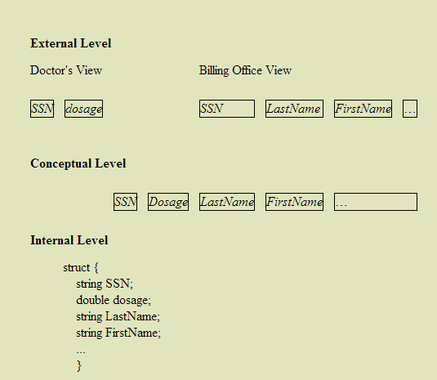
Three Level Architecture

Slide 6
Data Independence
Capacity to change schema at one level of database system without having to change schema at next higher level.
Physical data independence: The ability to modify physical level schema without affecting the logical or view level schema.
Performance tuning – modification at physical level creating a new index etc.

Slide 7
Logical data independence: The ability to change the
logical level scheme without affecting the view level schemes
or application programs
Adding a new attribute to some relation
no need to change the programs or views that don’t require to use the new attribute
Deleting an attribute
no need to change the programs or views that use the remaining data

Slide 8
Summary
DBMS used to maintain, query large datasets.
Benefits include recovery from system crashes, concurrent access, quick application development, data integrity and security.
Levels of abstraction give data independence.
A DBMS typically has a layered architecture.

